Slide 1
COMP6798001 Program Design Method D3092 – Irma Irawati Ibrahim

Slide 2

PROGRAM DESIGN METHOD
D3092
IRMA IRAWATI IBRAHIM, M.KOM.
Research:
ICIMTECH : Jakarta (Aug 2019) “ Facebook Analytics on Building Trust…”
KPDI9 – Makassar (Nov 2016) “Mobile Library Application”
KPDI 7 - Aceh (Nov 2014) “Model E-Learning dan sosial media …”
KPDI 6 - Malang (Nov 2013) “Grand Desain Pengayaan E-Resources di Univ”
KPDI 5 – Labuan Bajo (Oct 2012) "Dev of Digital Libraries in Computer Tablet”
Inter. Conference UI (Oct 2012) “Digital Library Based On HCI Principles”
CONSAL – Bali (May 2012) “How Tablet PC Technology can be Utilised in the Development of Libraries “
(2011) “Exam Information System Implementation.” ComTech, Vol.2, No. 1, June 2011, pg 13-22.
(2011) “Designing Information Systems Academic College of Higher Education based data / EPSBED.”ComTech, Vol. 2, No. 2, December.
(2012). Perancangan Sistem Informasi Mentoring untuk Perguruan Tinggi
Projects:
2017 - Team member of Salesforce implementation in BINUS University
2013 - Team member on Oracle Academic Services implementation project in BINUS University
2010 – 2013. Project Leader for BBS BPR Team – Reengineering All Academic and Support Application for BBS
Working (2002 – Present) : Deputy Campus Director BINUS @Senayan - Operations & Student Dev. Senior Manager Lecturer (2006 – Present): Subject : Human Computer Interaction, Software Engineering.
Program Design Method , MIS Education: 1997 – 2002 Bachelor In Library Science – University Of Indonesia 2004 – 2005 Master in Information Technology - University Of Indonesia

Slide 3
Topic
Input, Process, Output (L)
Function and Input Validation (L)
Files and menu driven programming (L)
Modules (L)
Decision Structure and Boolean Logic (L)
GUI and event driven programming (L)
Analysis Modeling (L)
Repetition (L)
Structural Modeling (L)
Design Model and Strategy (L)
Business Process and Functional Modeling (L)
Behavioral Modeling (L)
Class and Method Design (L)

Slide 4
Textbook
Tony Gaddis. (2019). Starting Out with Programming Logic and Design. 5. Pearson. New York. ISBN: 978-0- 134801155

Slide 5
Evaluasi
Assessment | Bobot
Assignment | 10%
Mid Exam | 35%
Final Exam | 35%
AoL Case Study | 20%

Slide 6
Project
1 kelompok terdiri dari 5-7 orang
Terdapat 2 bagian:
Part 1: Pseudocode dan Flowchart
Part 2: UML
Part 1: Menganalsis requirement untuk sebuah program menggunakan IPO charts, kemudian membuat algoritma dengan pseudocode dan flowchart
Part 2: Menganalisis proses dalam sebuah system dan membuat diagram UML untuk mendeskripsikan proses
Template lembar jawab akan diberikan
Jawaban disimpan dalam bentuk PDF dan di-submit ke Binusmaya oleh salah satu perwakilan grup

Slide 7
Project
Informasi kepada mahasiswa terkait tugas Case-Study Project pada Week 1 dan membuat kelompok paling akhir sebelum Mid Exam
Durasi pengerjaan Case-Study Project dimulai pada Week 8 (setelah Mid Exam) hingga Week 13 (Pertemuan terakhir)

Slide 8
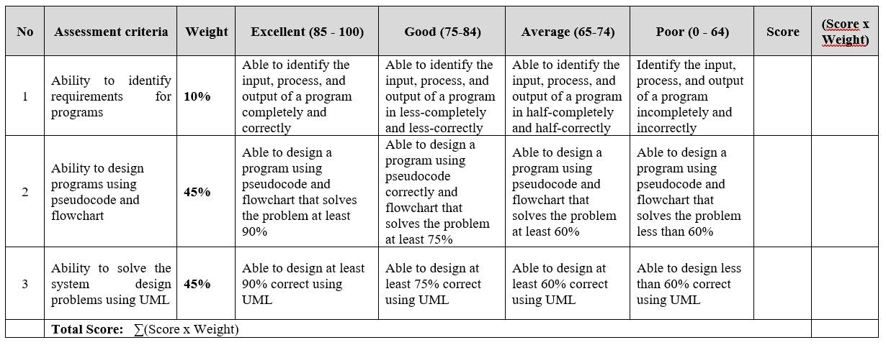
Rubrik Penilaian Project

Slide 9
Input, Process, Output Session 1
Course : COMP6056
Effective Period : September 2021

Slide 10
Sub Topics
designing Programs
Input, Output, variables
Assignment and Calculations
Declaration and Data Types
Named Constant
Hand Tracing a program
Documenting a program
Designing your first program

Slide 11
These slides have been adapted from: Gaddis, T. (2019). Starting Out with Programming Logic and Design 5^{th.} ISBN: 978-0-13-480115-5 Chapter 2
Acknowledgement

Slide 12
Learning Objectives
At the end of this lecture, students are able to:
LO1: To explain the program development cycle
LO2: To write pseudo-code to solve simple problem

Slide 13
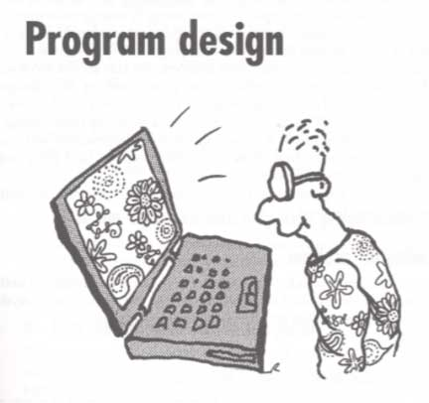
Program Design
Most good programs require good planning before they are written. This is called Program Design.

Slide 14
CHAPTER 1 : PROGRAM DESIGN
1.1 Steps in Program Development
1. Define the problem
4. Test the algorithm for correctness
7. Document and maintain the program
3. Develop the outline into an algorithm
2. Outline the solution
5. Code the algorithm into a specific programming language
6. Run the program on the computer

Slide 15
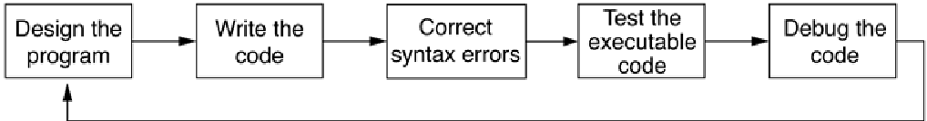
Designing a Program
The program development cycle
Gaddis, T., Starting Out With Programming Logic and Design, 5 ed, ISBN: 978-0-13-480115-5

Slide 16
Designing a Program
Two steps in designing a program
Understand the tasks that the program is to perform.
Learning what the customer wants.
Determine the steps that must be taken to perform the task.
Create an algorithm, or step-by-step directions to solve the problem.
Use flowcharts and/or pseudocode to solve.
Gaddis, T., Starting Out With Programming Logic and Design, 5 ed, ISBN: 978-0-13-480115-5

Slide 17
Defining the Problem
Defining the problem involves carefully reading and rereading the problem until understand completely what is required
To help with this initial analysis, the problem should be divided into three separate components
Input : a list of the source data provided to the problem
Output : a list of the outputs required
Processing : a list of actions needed to produce the required outputs

Slide 18
Designing a Program
Gaddis, T., Starting Out With Programming Logic and Design, 5 ed, ISBN: 978-0-13-480115-5

Slide 19
1.1.1 Define the Problem
Need to understand the problem, the requirement, the process require, etc.
To make easier the problem are divided into 3 components:
the inputs
the output
the processing steps to produce the required outputs
Example:
A program is required to prompt the terminal operator for the max and min temperature readings on particular day, except those readings as intergers, and calculate and display to the screen the average temperature, calculated by (max temp + min temp)/2
INPUT | PROCESSING | OUTPUT
Max_temp Min_temp | Prompt for temperatures Get temperatures Calculate average temperature Avg_temp=(Max_temp+Min_temp)/2 Display average temperature | Display Avg_temp

Slide 20
1.1.2 Outline the Solution
Once the problem has been defined, you may decide to break it down into smaller tasks or steps, and establish a solution outline.
The initial outline is usually a rough draft of the solution and may include:
The major processing steps involved
The major subtasks (if any)
The user interface (if any)
The major control structures (eg. Repetition loops)
The major variables and record structures
The mainline logic
The solution outline may also include a hierarchy or structure chart.

Slide 21
Designing a Solution Algorithm
Once the problem has been properly defined, the next step will be outline the solution
Pseudocode is useful present the solution algorithm

Slide 22
Designing a Program
Pseudocode
Fake code used as a model for programs
No syntax rules
Well written pseudocode can be easily translated to actual code
1.Display “Enter the number of hours”
2.Input hours
3.Display “Enter the hourly pay rate”
4.Input payRate
5.Set grossPay = hours * payRate
6.Display “The gross pay is $”, grossPay
Gaddis, T., Starting Out With Programming Logic and Design, 5 ed, ISBN: 978-0-13-480115-5

Slide 23
Designing a Program
Flowcharts
A diagram that graphically depicts the steps that take place in a program
Terminator used for start and stop
Parallelogram used for input and output
Rectangle used for processes
Flow
Gaddis, T., Starting Out With Programming Logic and Design, 5 ed, ISBN: 978-0-13-480115-5

Slide 24
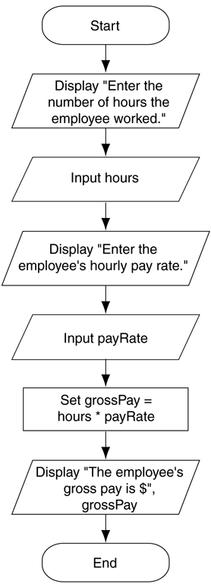
Designing a Program
Example:
Flowchart for the pay calculating program
Gaddis, T., Starting Out With Programming Logic and Design, 5 ed, ISBN: 978-0-13-480115-5

Slide 25
Output, Input, and Variables
Output – data that is generated and displayed
Input – data that a program receives
Variables – storage locations in memory for data
Computer programs typically follow 3 steps
Input is received
Some process is performed on the input
Output is produced
Gaddis, T., Starting Out With Programming Logic and Design, 5 ed, ISBN: 978-0-13-480115-5

Slide 26
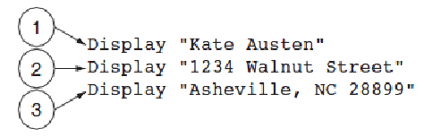
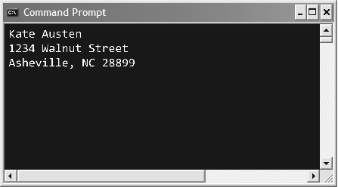
Output, Input, and Variables
Display is the keyword to show output to the screen
Sequence – lines execute in the order they appear
String Literals – a sequence of characters
The statements execute in order
Output of Program 2-1
Gaddis, T., Starting Out With Programming Logic and Design, 5 ed, ISBN: 978-0-13-480115-5

Slide 27
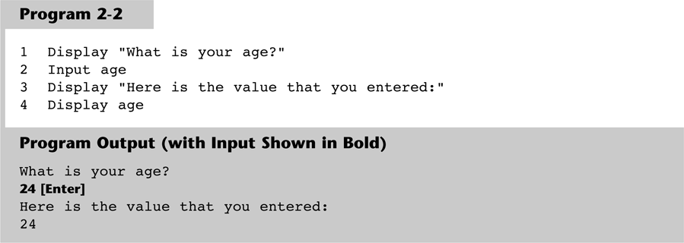
Output, Input, and Variables
Input is the keyword to take values from the user of the program
It is usually stored in variables
Gaddis, T., Starting Out With Programming Logic and Design, 5 ed, ISBN: 978-0-13-480115-5

Slide 28
Output, Input, and Variables
Programmers can define variable names following certain rules
Must be one word, no spaces
Generally, punctuation characters are avoided
Generally, the first character cannot be a number
Name a variable something that indicates what may be stored in it
camelCase is popular naming convention
Student_1 ; tempMhs ; grade_student
Gaddis, T., Starting Out With Programming Logic and Design, 5 ed, ISBN: 978-0-13-480115-5

Slide 29
Output, Input, and Variables
IPO Charts
gross_pay=work_hours*pay_rate
Display gross_pay
work_hours
pay_rate
Gaddis, T., Starting Out With Programming Logic and Design, 5 ed, ISBN: 978-0-13-480115-5

Slide 30
Output, Input, and Variables
Strings and Literals
String appear in actual code
Usually enclosed in double quote mark
Gaddis, T., Starting Out With Programming Logic and Design, 5 ed, ISBN: 978-0-13-480115-5

Slide 31
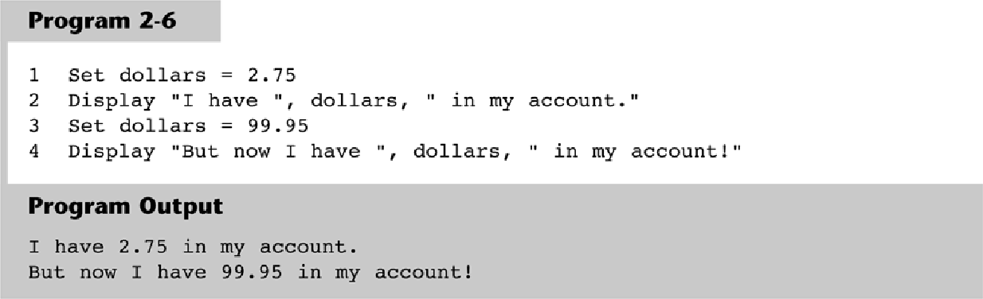
Output, Input, and Variables
Variable Assignment & Calculations
Variable assignment can come from user input and also can be set through an assignment statement
set price = 20 or set price to 20
Set dollars_A = 2.75
Display “I have “ ,dollars_A, “in my account”
Set dollars_B = 99.95
Display ‘But now I have”, dollars_B, “in my account”
Gaddis, T., Starting Out With Programming Logic and Design, 5 ed, ISBN: 978-0-13-480115-5

Slide 32
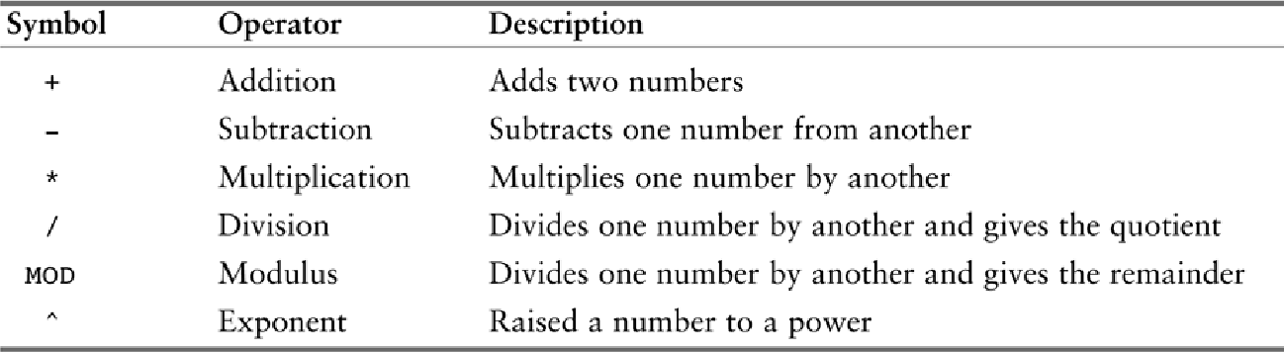
Output, Input, and Variables
Calculations are performed using math operators
The expression is normally stored in variables
Set sale = price – discount
Common math operators
Gaddis, T., Starting Out With Programming Logic and Design, 5 ed, ISBN: 978-0-13-480115-5

Slide 33
Output, Input, and Variables
Variable Declarations & Data Types
A variable declaration includes a variable’s name and a variable’s data type
Data Type – defines the type of data you intend to store in a variable
Integer – stores only whole numbers
Real – stores whole or decimal numbers
String – any series of characters
Character – one character only
Example: Declare Real grossPay
Gaddis, T., Starting Out With Programming Logic and Design, 5 ed, ISBN: 978-0-13-480115-5

Slide 34
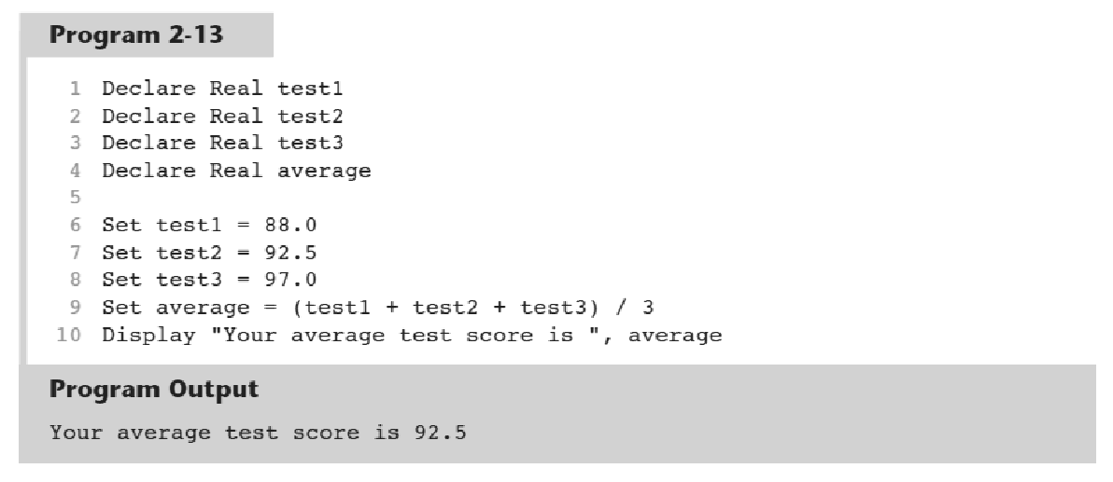
Output, Input, and Variables
For safety and to avoid logic errors, variables should be initialized to 0 or some other value
Gaddis, T., Starting Out With Programming Logic and Design, 5 ed, ISBN: 978-0-13-480115-5

Slide 35
Named Constants
A named constant is a name that represents a value that cannot be changed
Makes programs more self explanatory
If a change to the value occurs, it only has to be modified in one place
Constant Real INTEREST_RATE = 0.069
Gaddis, T., Starting Out With Programming Logic and Design, 5 ed, ISBN: 978-0-13-480115-5

Slide 36
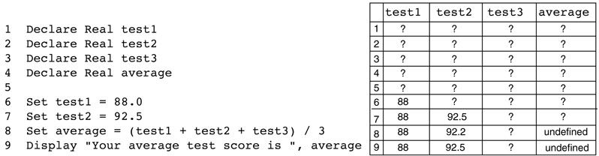
Hand Tracing a Program
Hand tracing is a simple debugging process for locating hard to find errors in a program or to ensure the correctness of a program
Involves creating a chart with a column for each variable, and a row for each line of code
Gaddis, T., Starting Out With Programming Logic and Design, 5 ed, ISBN: 978-0-13-480115-5

Slide 37
Documenting a Program
External documentation describes aspects of the program for the user, sometimes written by a technical writer
Internal documentation explains how parts of the program works for the programmer, also known as comments
// comments are often distinguished within
// the program with line comments
Gaddis, T., Starting Out With Programming Logic and Design, 5 ed, ISBN: 978-0-13-480115-5

Slide 38
Designing Your First Program
Calculate the batting average for any player
Batting Average = Hits ÷ Times at Bat
Determine what is required for each phase of the program:
What must be read as input?
What will be done with the input?
What will be the output?
INPUT | PROCESS | OUTPUT
Hits Times_bat | Get Hits Get Times_bat Calculate Batting_Average =Hits/Times_bat Display Batting_Average | Batting_Average
Gaddis, T., Starting Out With Programming Logic and Design, 5 ed, ISBN: 978-0-13-480115-5

Slide 39
Designing Your First Program
Input is received.
The number of hits
The number of times at bat
Some process is performed on the input.
Calculate the batting average
Divide the number of hits by the number of times at bat
Output is produced.
The player’s batting average
Gaddis, T., Starting Out With Programming Logic and Design, 5 ed, ISBN: 978-0-13-480115-5

Slide 40
Designing Your First Program
IPO Chart
Gaddis, T., Starting Out With Programming Logic and Design, 5 ed, ISBN: 978-0-13-480115-5

Slide 41
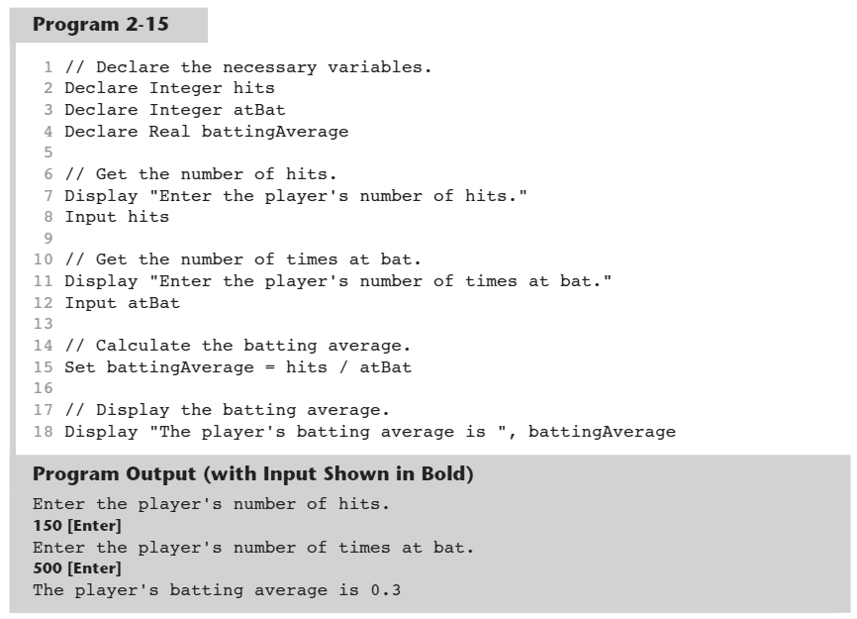
Designing Your First Program
Pseudocode
Gaddis, T., Starting Out With Programming Logic and Design, 5 ed, ISBN: 978-0-13-480115-5

Slide 42
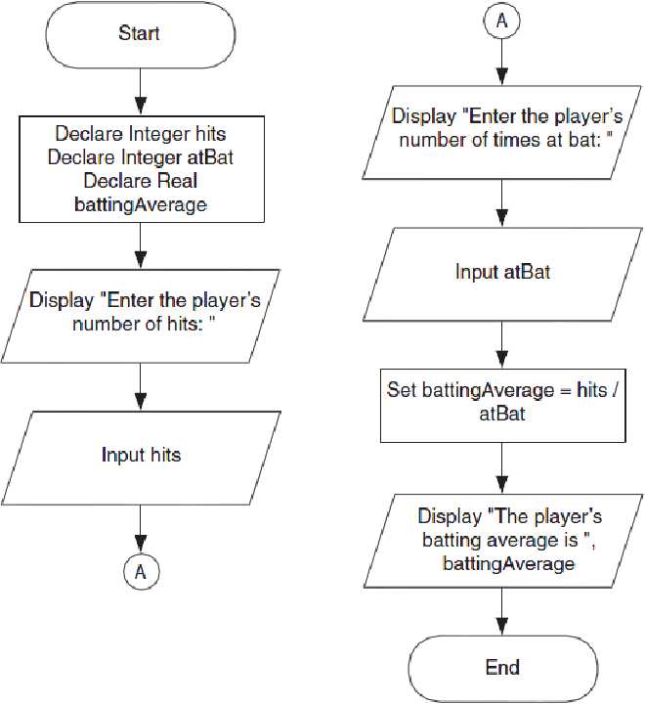
Designing Your First Program
Flowchart
Gaddis, T., Starting Out With Programming Logic and Design, 5 ed, ISBN: 978-0-13-480115-5

Slide 43
1.1.3 Develop The Outline Into an Algorithm
Algorithm is a set of precise steps that describe exactly the tasks to be performed and the order in which they are to be carried out.
We use pseudocode (a form of structured English) to represet the solution algorithm.
1.1.4 Test The Algorithm For Correctness
This step is the most important, yet it is the step most often by passed.
The main purpose is to identify major logic error early, so that they may be easily corrected.
Test data needs to be walked through each step in the algorithm, keep track of all major variables to check the instructions described in the algorithm will actually do what they are supposed to.

Slide 44
Checking the Solution Algorithm
After a solution algorithm has been established, it must be tested for correctness
Desk checking involves tracing through the logic of the algorithm with some chosen test data. That is, “walk” through the logic of the algorithm exactly as a computer would, keeping track of all major variable values on a sheet of paper

Slide 45
Checking the Solution Algorithm
There are six simple steps to follow when desk checking an algorithm:
Choose simple input test cases that are valid. Two or three test cases are usually sufficient
Establish what the expected result should be for each test case
Make a table on a piece of paper of the relevant variable names within the algorithm
Walk the first test case through the algorithm, line by line, keeping a step – by – step record of the contents of each variable in the table as the data passes through the logic
Repeat the walk-through process using the other test data cases, until the algorithm has reached its logical end
Check that the expected result established in step 2 matches the actual result developed in step 5

Slide 46
Designing Your First Program
Hand Tracing
Gaddis, T., Starting Out With Programming Logic and Design, 5 ed, ISBN: 978-0-13-480115-5

Slide 47
1.1.5 Code the algorithm into a specific programming language
Only after all design constructions in the previous 4 steps have been met should you actually start to code the program into your chosen programming language.
1.1.6 Run the program on the computer
This step uses a program compiler and programmer-designed test data to machine test the code for syntax error (those detected at compile time) and logic error (those detected at run time).
This is usually the most rewarding step in the program development process. If the program has been well designed, the time-wasting frustration and despair often associated with program testing are reduced to a minimum.
This step may need to be performed several times until you are satisfied that the program is running as required.

Slide 48
1.1.7 Document and Maintain the Program
Program documentation should not be listed as the last step in the program development process, as it is really an ongoing task from the initial definition of the problem to the final test result.
Documentation includes both external documentation (such as hierarchy charts, the solution algorithm and test data results) and internal documentation that may have been coded in the program.
Program maintenance refers to changes that may need to a program throughout its life. Often these changes are performed by a different programmer from the one who initially wrote the program.
If the program has been well designed using structured programing techniques, the code will be seen as self-documenting, resulting in easier maintenance.

Slide 49
References
Gaddis, T. (2019). Starting Out with Programming Logic and Design 5th. ISBN: 978-0-13-480115-5

Slide 50
CASES Exercise
Design an algorithm that will read two numbers and an integer code from the screen. The value of the integer code should be 1,2,3 or 4. If the value of the code is 1, compute the sum of the two numbers. If the code is 2, compute the difference (first minus second). If the code is 3, compute the product of the two numbers. If the code is 4, and the second number is not zero, compute the quotient (first divided by second). If the code is not equal to 1,2,3 or 4 display an error message. The program is then to display the two numbers, the integer code and the computed result to the screen.
Input | Processing | Output
number_1 number_2 Int_code | Read number_1 Read number_2 Read Int_code Declare result IF int_code = 1 then set result=number_1+number_2 IF int_code = 2 THEN…. IF int_code = 3 THEN…. IF int_code = 4 AND number_2=! 0 THEN result = number_1/number_2 ELSE Display “Error” | number_1, number_2, int_code, result

